Slide 1
Asthma and COPD – they do overlap
The content in this session is valid at date of presentation
Thursday 1 August 2024

Slide 2


Acknowledgement of Country
North Western Melbourne Primary Health Network would like to acknowledge the Traditional Custodians of the land on which our work takes place, The Wurundjeri Woi Wurrung People, The Boon Wurrung People and The Wathaurong People.
We pay respects to Elders past, present and emerging as well as pay respects to any Aboriginal and Torres Strait Islander people in the session with us today.

Slide 3

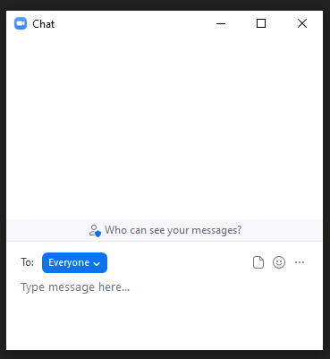
Housekeeping – Zoom Meeting
All attendees are muted
Please keep your microphone on mute
Please ask questions via the Chat box
This session is being recorded
Please ensure you join the session using the name you registered with so we can mark your attendance
Certificates will not be issued if we cannot confirm your attendance

Slide 4
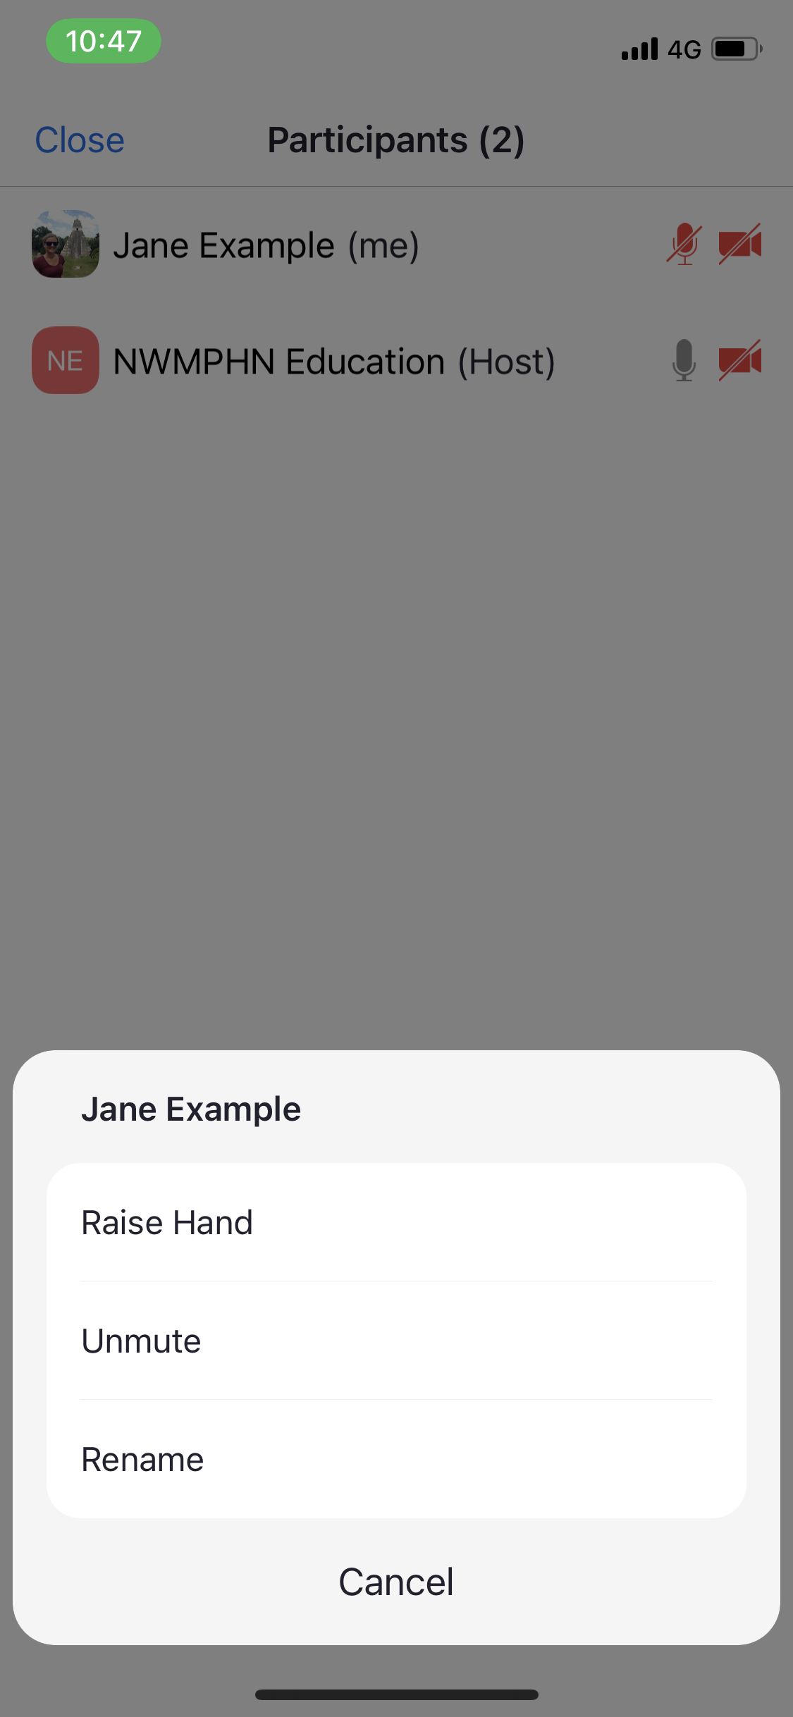
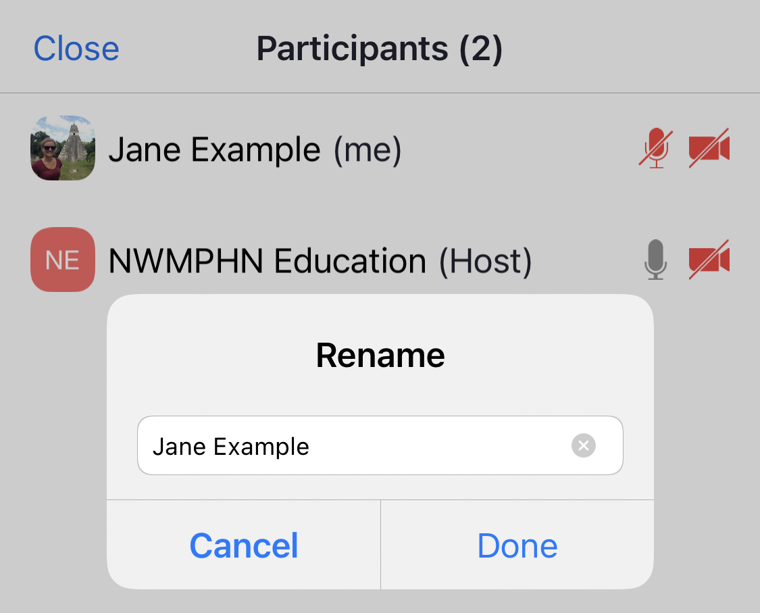
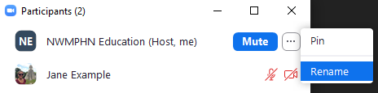
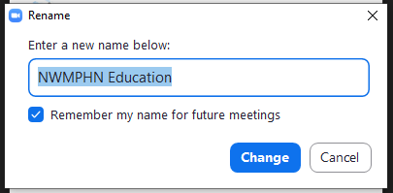
How to change your name in Zoom Meeting
1. Click on Participants
2. App: click on your name
Desktop: hover over your name and click the 3 dots
Mac: hover over your name and click More
3. Click on Rename
4. Enter the name you registered with and click
Done / Change / Rename

Slide 5
Speakers
Adila Lundin, HealthPathways Melbourne Program Officer
Adila has been working with the HealthPathways Melbourne team for one year and has a background in Public Health.
Narelle Williamson
Narelle is a registered nurse and respiratory educator, with over 25 years’ experience in acute hospital settings, primary health care and paediatric palliative care.
Narelle has developed nurse-led respiratory clinics in primary care for the past 12 years, most recently in Melbourne’s east. She also travels Australia-wide, educating GP’s, practice nurses and pharmacists in respiratory health, as part of the National Asthma Council’s education program, recently resigning after three years as their Senior Clinical Consultant.

Slide 6
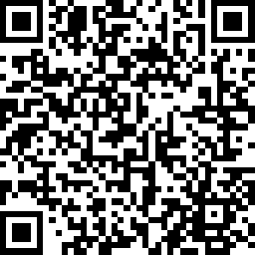
Session Conclusion
You will receive a post session email within a week which
will include slides and resources discussed during this session.
Attendance certificate will be received within 4-6 weeks.
RACGP CPD hours will be uploaded within 30 days.
To attend further education sessions, visit,
https://nwmphn.org.au/resources-events/events/
This session was recorded, and you will be able to view the
recording at this link within the next week.
https://nwmphn.org.au/resources-events/resources/
We value your feedback, let us know your thoughts.
Scan this QR code

