Slide 1

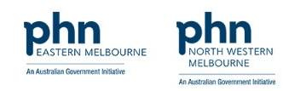
Asthma and COPD overlap 1 August 2024 Adila Lundin – Program Officer

Slide 2

Pathways are written by GP clinical editors with support from local GPs, hospital-based specialists and other subject matter experts
clear and concise, evidence-based medical advice
Reduce variation in care
how to refer to the most appropriate hospital, community health service or allied health provider.
what services are available to my patients
Notes:
HealthPathways provides clinicians with a single website to access a comprehensive collection of locally relevant clinical information and guidelines
Pathways are designed to support general practitioners (GPs) and other healthcare providers in delivering consistent and evidence-based care to their patients.
HealthPathways Melbourne is a collaborative program run by the Eastern Melbourne PHN (EMPHN), and North Western Melbourne PHN (NWMPHN), and is supported by local GPs, hospitals, health networks, community health providers and other health professionals.
HealthPathways is an online resource that provides clinicians with a single website to access a comprehensive collection of locally relevant clinical information and guidelines designed to support general practitioners (GPs) and other healthcare providers in delivering consistent and evidence-based care to their patients

Slide 3

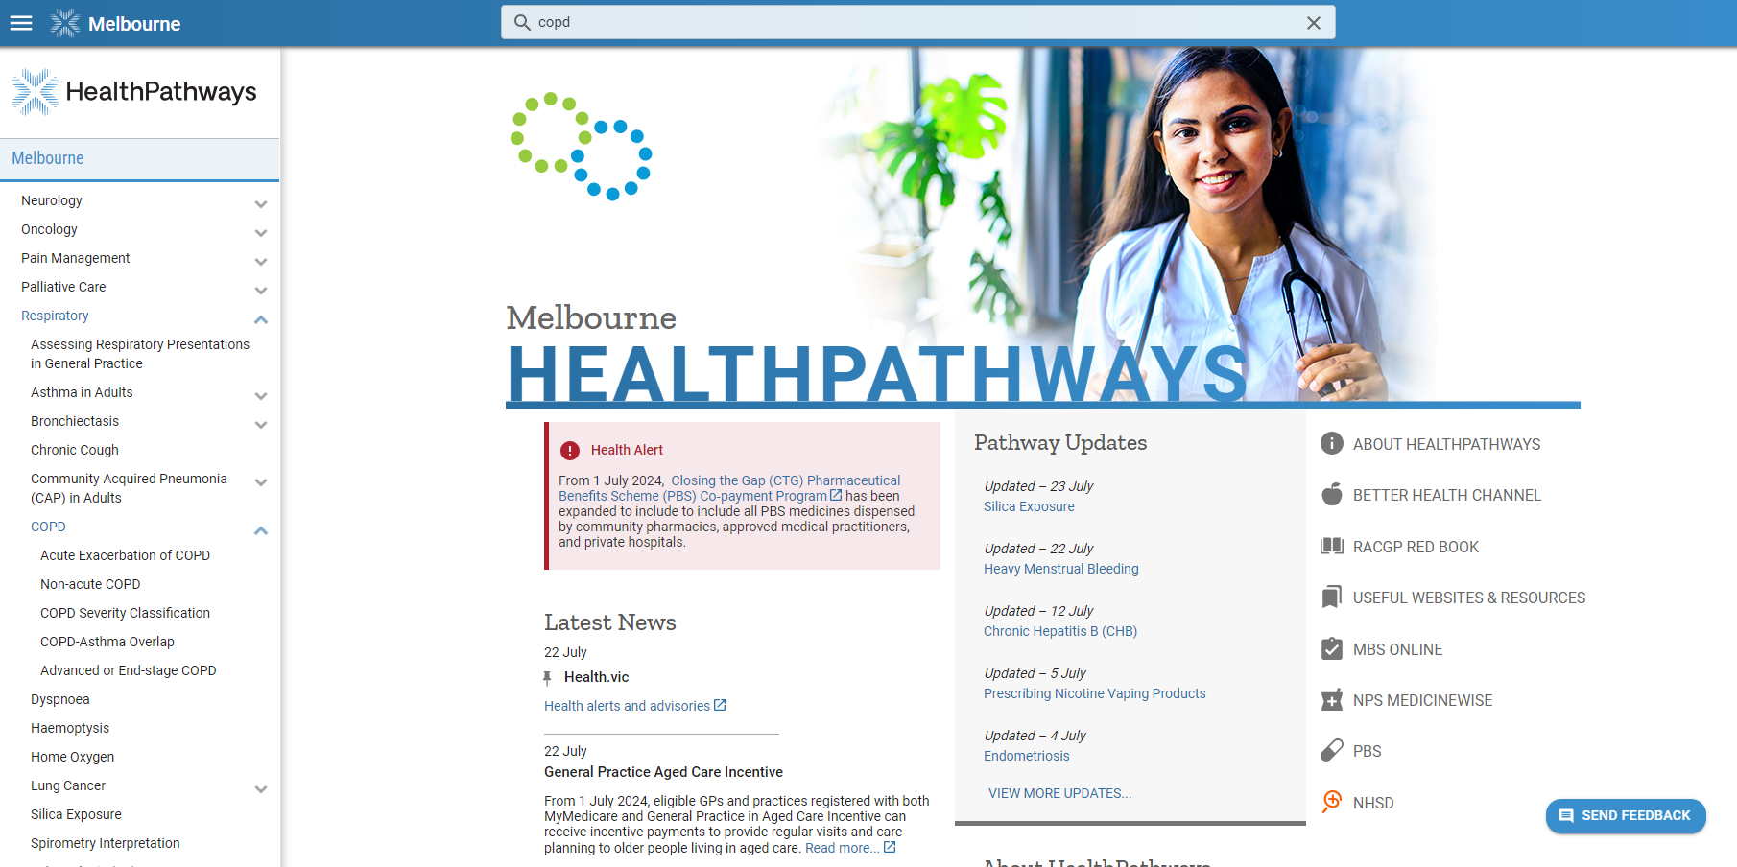
Where to find the respiratory suite:
Click here to provide feedback on each pathway
Notes:
This presentation will demonstrate how to access and navigate HealthPathways Melbourne to find relevant pathways and referral options for this topic

Slide 4
Recently updated and under review pathways
Clinical pathways
Referral pathways
Respiratory Referrals
Paediatric Respiratory Referrals
Acute Respiratory Referral or Admission (Same-day)
Non-acute Respiratory Referral (> 24 hours)
Lung Function Testing
Pulmonary Rehabilitation
Home Oxygen Referral
Acute Exacerbation of COPD Non-acute COPD COPD Severity Classification COPD-Asthma Overlap Advanced or End-stage COPD Assessing Respiratory Presentations in General Practice Acute Asthma in Children Asthma in Adolescents (Aged 12 Years and Over) Asthma in Primary School-aged Children (Aged 6 to 11 Years) Wheeze and Asthma in Preschool Children (Aged 1 to 5 Years) Asthma in Adults - Acute Asthma in Adults - Non-acute Asthma in Pregnancy Thunderstorm Asthma Bronchiectasis Chronic Cough
Notes:
We are currently reviewing several respiratory pathways, including updates to align with new Statewide Referral Criteria. We encourage you to visit HealthPathways, to access more information on asthma and copd, and a range of other respiratory pathways.

Slide 5
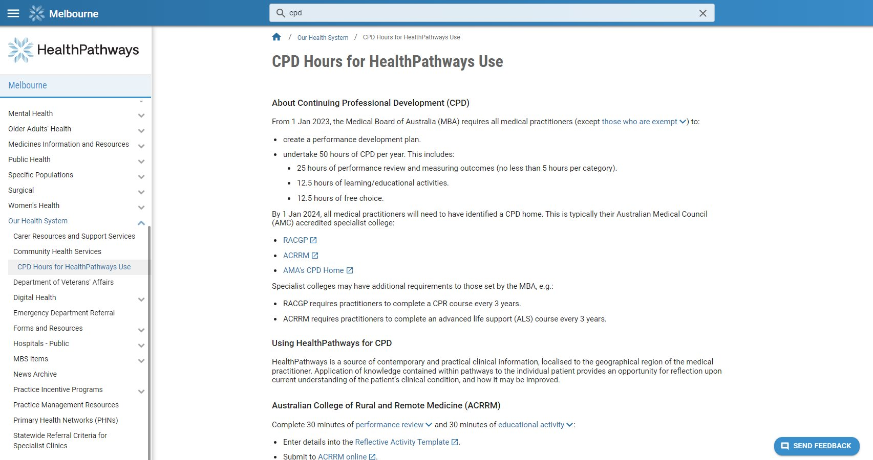
CPD Hours for HealthPathways Use
Notes:
You may not be aware that HealthPathways is a tool that can help you with reflective learning that contributes to CPD hours.
For both the Australian College of Rural and Remote Medicine (ACRRM) and The Royal Australian College of General Practitioners (RACGP) you need to complete 30 minutes each of a performance review and educational activity.
After completing these, enter the details into the Reflective Activity Template and submit them online with the links or via the myCPD app, available on Android or iOS."

Slide 6
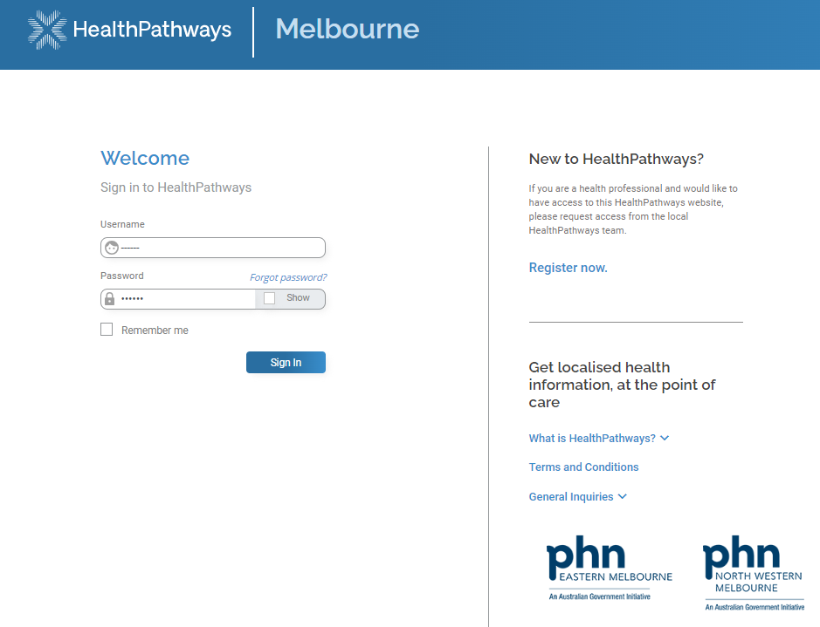
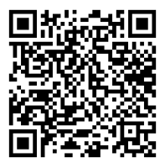


Accessing HealthPathways
melbourne.healthpathways.org.au
info@healthpathwaysmelbourne.org.au
Notes:
To access HealthPathways Melbourne, go to the website address melbourne.healthpathways.org.au
HealthPathways Melbourne is available to General Practice Teams and other clinicians in the Eastern Melbourne PHN and North Western Melbourne PHN catchments.
If you don’t have access yet, you can click on REGISTER, which brings up an online form. WE can also organise automatic login for you so you can access HealthPathways without a username and password.
Just email the team on info@healthpathwaysmelbourne.org.au.

