Slide 1
Early identification and management of developmental delay in children
Tuesday, 3rd December 2024
The content in this session is valid at date of presentation

Slide 2


Acknowledgement of Country
North Western Melbourne Primary Health Network would like to acknowledge the Traditional Custodians of the land on which our work takes place, The Wurundjeri Woi Wurrung People, The Boon Wurrung People and The Wathaurong People. We pay respects to Elders past, present and emerging as well as pay respects to any Aboriginal and Torres Strait Islander people in the session with us today.

Slide 3

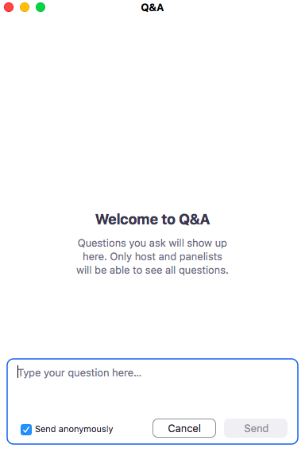
Housekeeping – Zoom Webinar
All attendees are muted
Please ask questions via the Q&A box only
Q&A will be at the end of the presentation
This session is being recorded
Questions will be asked anonymously to protect your privacy

Slide 4
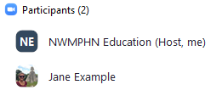
Housekeeping – Zoom Webinar
Please ensure you have joined the session using the same name as your event registration (or phone number, if you have dialled in)
NWMPHN uses Zoom’s participant list to mark attendance and certificates and CPD will not be issued if we cannot confirm your attendance.
If you are not sure if your name matches, please send a Chat message to ‘NWMPHN Education’ to identify yourself.
Day Date Month Year

Slide 5

Early identification and management of developmental delay in children
03 December 2024
​

Slide 6

Pathways are written by GP clinical editors with support from local GPs, hospital-based specialists and other subject matter experts
clear and concise, evidence-based medical advice
Reduce variation in care
how to refer to the most appropriate hospital, community health service or allied health provider.
what services are available to my patients
Notes:
HealthPathways Melbourne is a collaborative program run by the Eastern Melbourne PHN (EMPHN), and North Western Melbourne PHN (NWMPHN), and is supported by local GPs, hospitals, health networks, community health providers and other health professionals.
It is a single website that provides clinicians access to a comprehensive collection of locally relevant clinical information and guidelines and are designed to support general practitioners (GPs) and other healthcare providers in delivering consistent and evidence-based care to their patients. It includes medication information, referral information and further resources which can be used at the point of care. Say a GP is new to an area and not very familiar with perinatal mental health, they can jump online to HealthPathways, check the local assessment, management AND referral criteria for services within their catchment.

Slide 7
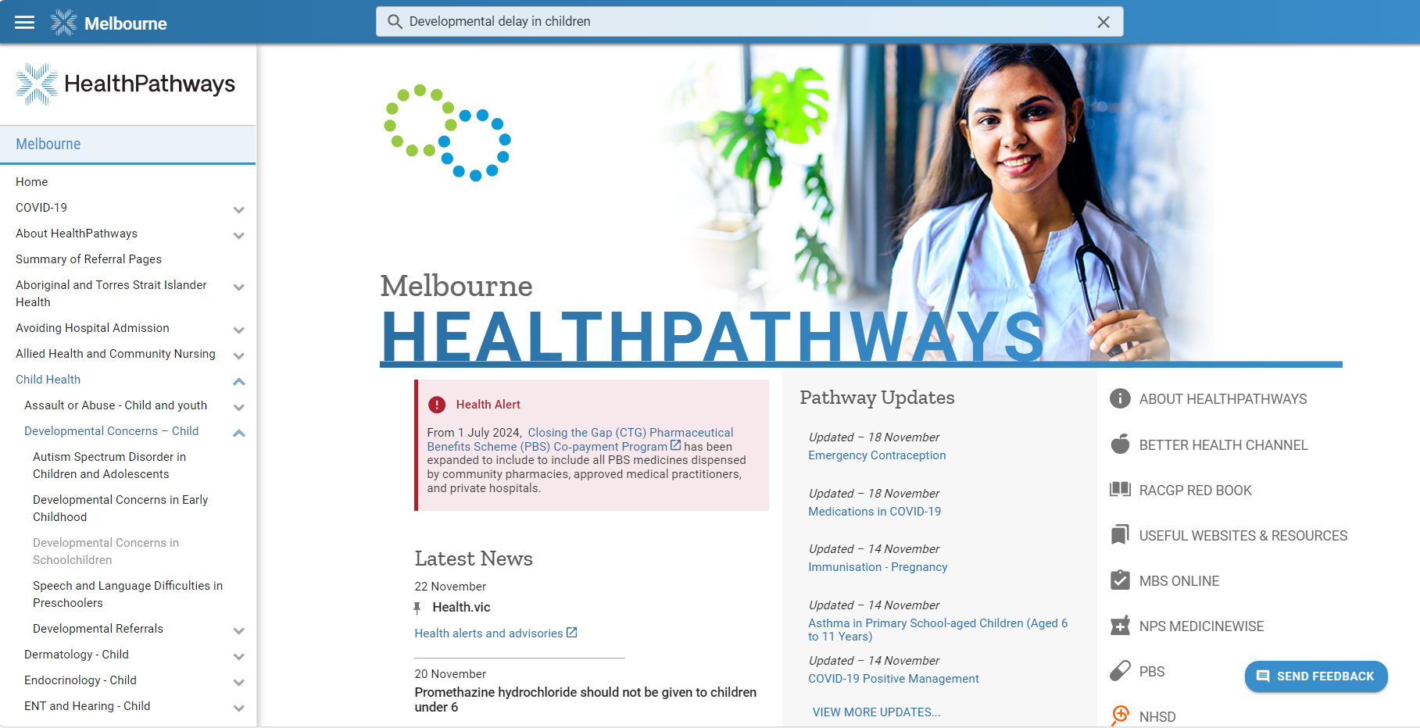
HealthPathways – Early identification and management of developmental delay in children
Click ‘Send Feedback’ to add comments and questions about this pathway.
Notes:
This presentation will demonstrate how to access and navigate HealthPathways Melbourne to find relevant pathways on Developmental concerns in Early Childhood

Slide 8
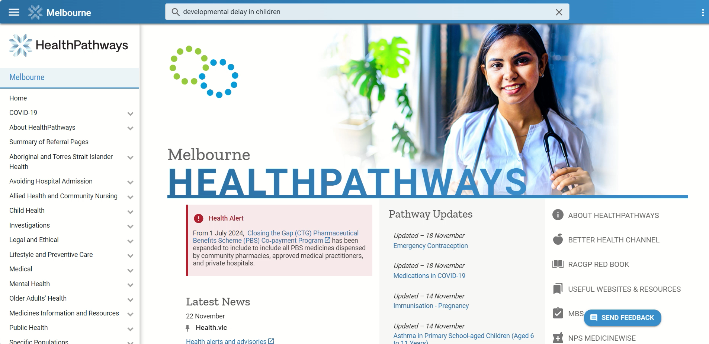
HealthPathways – Early identification and management of developmental delay in children
Notes:
Navigating HealthPathways
Visit the HealthPathways Melbourne website and log in.
Here you can see the homepage. Latest updates and Pathway updates.
Search for the Relevant Pathway: You can use the search bar located at the top of the page to enter relevant keywords like “developmental delay in children” or alternately you can use the table of contents on the Left-hand side of the page .
Select the pathway that matches your search to access the detailed information. Today we are choosing the 'Developmental Concerns in Early Childhood’ pathway
Background is a brief overview of core background information (relevant definitions, epidemiology, and general contextual information)
Assessment Section: This section provides a simple list of steps for users to follow when evaluating and diagnosing a patient's condition at the point of care. There are drop-down boxes along the pathway offering supplementary information, like biological risks, developmental screening tool and details on exams to perform, and list of common causes of developmental delay.
Management Section: This section outlines a clear list of actions users may need to take, with additional details to help carry out those actions. It also includes links to further resources, such as information on Early Childhood Approach (ECA).
By clicking on Early Childhood Approach (ECA), users are directed to the Early Childhood Approach (ECA) referral page.
Here you can see- A Clinical editor's note, it is a concise, temporary addition by a senior clinical editor. It enables users to swiftly access significant new or changed information that directly affects local user practice.
Referral section -this section includes locally relevant requests and referrals that the clinician might request from a third party for their patient. Here, it provides the eligibility criteria for ECA services.As we go down, We can find services in North Western Melbourne. The drop boxes provide additional information for the referrer including service specific criteria and it links out to referral information.
Scrolling down to the bottom of the page you will find the
The information section at the bottom of the pathway provides is a selective list of links to useful information, specific to the health professionals and the patient

Slide 9
HealthPathways – Relevant Pathways
Developmental Concerns-Child
Autism Spectrum Disorder in Children and Adolescents
Developmental Concerns in Early Childhood
Speech and Language Difficulties in Preschoolers
Related Pathways
Health Assessment for People with an Intellectual Disability.
GP Management Plan and Team Care Arrangement.
Immunisation Services
Parent Infant Community Support
CPD Hours for HealthPathways Use
Developmental Referrals​
Early Childhood Approach (ECA)​
Maternal and Child Health​
Paediatric Occupational Therapy Referral​
Paediatric Physiotherapy Referral​
Paediatric Speech Pathology Referral​
Specific Learning Difficulties Support​
Paediatric Psychology and Counselling Referral​
Acute Paediatric Medicine Referral or Admission (Same-day)​
Non-acute Paediatric Medicine Referral (> 24 hours)​
Paediatric Dietetic Referral​
Notes:
This slide provides a list of relevant pathways to our presentation
Developmental concerns in Children
Developmental referrals
Related pathways
CPD Hours for HealthPathways use
​
​​
​

Slide 10
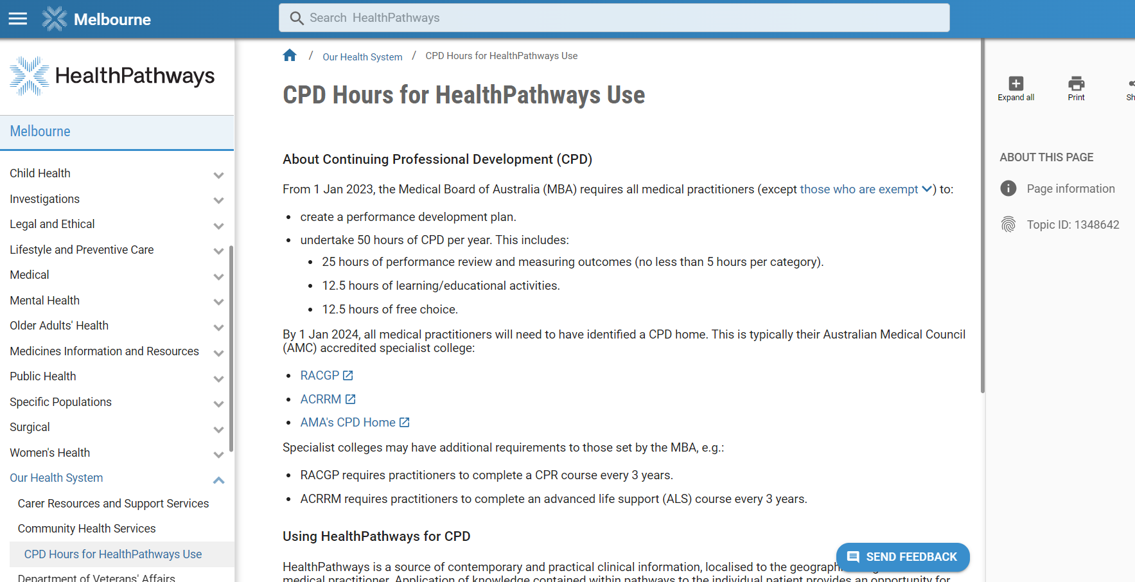
CPD Hours for HealthPathways Use
Notes:
You may not be aware that HealthPathways is a tool that can help you with reflective learning that contributes to CPD hours.
For both the Australian College of Rural and Remote Medicine (ACRRM) and The Royal Australian College of General Practitioners (RACGP) you need to complete 30 minutes each of a performance review and educational activity.
After completing these, enter the details into the Reflective Activity Template and submit them online with the links or via the myCPD app, available on Android or iOS."

Slide 11


Accessing HealthPathways
HealthPathways Melbourne (HPM) is boosting user safety by upgrading its security protocols and we are transitioning to personalised accounts
Existing users: This means you'll have to set up a new account before 13 January 2025 – but doing so is simple, fast and guarantees your online safety! Head to HPM melbourne.healthpathways.org.au and click on the yellow banner at the top of the screen inviting you to start the process. We recommend you make the switch now with your staff teams. Existing accounts /logins will stay live until 12 January 2025.
For new users click on the Register button to create your individual account or scan the QR code
If you have any questions, please email the team info@healthpathwaysmelbourne.org.au.
Notes:
HealthPathways Melbourne is available to General Practice Teams and other clinicians within the Eastern Melbourne PHN and North Western Melbourne PHN catchments.
HealthPathways Melbourne is now transitioning to personalised accounts for improved online security. Creating an account is quick, simple
Visit melbourne.healthpathways.org.au
For Existing Users Log in to HealthPathways Melbourne and follow the yellow banner to transition to a personalised account. Shared accounts will close on 13 January 2025—complete your transition now to avoid any disruptions.
For new users click on the Register button to create your individual account or scan the QR code on this slide
If you have any questions, please email the team info@healthpathwaysmelbourne.org.au.

Slide 12
Speaker
Dr Riju Mittal – Consultant Paediatrician
Western Health
Dr. Riju Mittal brings over 24 years of experience in Paediatrics in Melbourne, specialising in addressing the complex developmental and behavioural needs of children. Her expertise covers a wide range of conditions including Developmental and Intellectual Disabilities, Autism Spectrum Disorders, and ADHD. She holds dual qualifications in General Paediatrics and Community Child Health. Dr. Mittal’s practice is firmly grounded in evidence and stays current through active participation in relevant conferences and memberships in professional societies such as the Australasian Society for Developmental Paediatrics (ASDP), Australian ADHD Professionals Association (AADPA) and American Academy of Child and Adolescent Psychiatry (AACAP). She regularly contributes to medical education by providing formal teaching to paediatricians, trainees, and medical students. In addition to English, Dr. Mittal is proficient in Hindi and Marathi, which enhances her ability to connect with a diverse range of patients and families.

Slide 13
Early identification and management of developmental delay in children
Dr Riju Mittal
Consultant Paediatrician, Western Health
Paediatrician and Director, Western Children's Health Centre, Laverton
3rd December 2024

Slide 14
Objectives of the Presentation
Understand importance of early detection of developmental delays
Learn key milestones and red flags across developmental domains
Explore practical tools for screening and assessment
Outline initial management and referral pathways

Slide 15
Jordan
3-year-old Caucasian boy
Mother seeking advice regarding his speech delay
Preschool teachers have told her that he is slow in speech compared to his classmates.
Jordan has a vocabulary of about 10–12 words and has not started speaking in phrases
He can respond to his name and can follow simple instructions

Slide 16
Dante
18-month-old child from a Sudanese background, recently migrated to Australia, Dad speaks good English and is interpreting for mum
During an immunisation catch-up session, you note that the child is not speaking, has minimal eye contact, no pointing
When discussed with the parents, they express some concern about a possible speech delay but remain hopeful that the child will improve over time
The child does not attend childcare
On observations: No dysmorphic facial features, the child is otherwise in good health. He is observed to be playing alone in the room, not engaging with siblings, exhibiting rough play, highly active, attempting to hit parents, and trying to escape the room

Slide 17
GP as the First Point of Call
Best placed to see the child from a holistic point of view in the context of the family’s mental and social needs
Can initiate referrals before child sees specialist leading to significant positive long-term outcomes
Can be the first one to pick even when no concerns raised

Slide 18
Importance of Early Identification
Early childhood development is a rapid and critical development period from birth to five years - brain develops faster than at any other time in life
Quality nurturing care during this period—including adequate nutrition, access to quality healthcare, and early childhood education—is vital for children's development
Improved outcomes with early intervention

Slide 19
Importance of Early Identification
Parents are usually the first to pick up signs of possible developmental delay, and any concerns parents have about their child’s development should always be taken seriously
On the other hand, the absence of parental concern does not necessarily mean that all is well

Slide 20





Childhood development - 5 domains
Motor
Cognitive
Language
Social-emotional
Daily life skills

Slide 21
Motor Domain
Gross motor skills - moving large muscles and involves whole-body movements and physical activities such as walking, running, jumping, balancing, and lifting
Fine motor skills - small body muscles, such as those in hands, wrists, and fingers finger eye and finger mouth coordination such as writing, using cutlery, tying shoelaces, turning doorknobs, opening zippers, and brushing teeth etc

Slide 22
Cognitive domain
Problem solving
Learning
Process thoughts
Pay attention
Develop memories
Understand surroundings
Express creativity
Create and develop plans

Slide 23
Language domain
Three components –
Understanding – Receptive language
Expressing –
1. Verbal - Expressive language
2. Non-verbal – Pragmatic language
Developing language skills is the first step in literacy as it forms the foundations for early reading and writing
Receptive language is the best indicator for future intelligence

Slide 24
Social-emotional domain
Interaction and forming relationships with others and experiencing, expressing, and managing their own emotions and emotions of others
Taking turns
Regulating emotions
Sharing
Apologising
Developing friendships
Having empathy toward others

Slide 25
Activities of daily living
Includes feeding
Toileting
Helping with dressing
Hygiene

Slide 26
Key Developmental Milestones
Age | Gross Motor | Fine Motor | Speech/Language | Social/Emotional
6 months | Rolls over both ways | Reaches for objects | Responds to sounds | Smiles socially
12 months | Stands with support | Pincer grasp | Says single words | Waves 'bye-bye'
2 years | Runs, kicks a ball | Builds tower of 4 blocks | Combines two words | Imitates adults' actions
3 years | Climbs stairs alternating | Copies a circle | Speaks in sentences | Plays pretend with others
4 years | Hops on one foot | Uses scissors | Tells stories | Cooperates with peers
5 years | Skips, balances on one foot | Writes some letters or numbers | Follows multi-step commands | Shows independence

Slide 27
Global developmental delay
Arbitrary term used for significantly delayed development in more than 2 domains in children <5 years old
GDD may be used as a provisional diagnosis until comprehensive standardised testing can be accurately and reliably completed and identify areas of precise delay

Slide 28
Intellectual disability
Intellectual disability is a life long neurodevelopmental disorder
Affects a child's intellectual and adaptive functioning
Intellectual domain - skills in language, reading, writing, math, reasoning, knowledge, and memory
Adaptive domain – ability to independently, work, live or play
Notes:
and extends to other self-management in areas such as personal care, job, money management, recreation, and organising school and work tasks

Slide 29
Intellectual disability
ID diagnosis used for children >5 years of age as IQ testing more accurate, while GDD is the preferred term in children <5 years
However, a diagnosis of ID can be made earlier if the child meets ID criteria
Not all children with GDD meet criteria for ID as they grow older

Slide 30
Statistics
Developmental delays are common in childhood, 10%–15% of preschool children
Global developmental delays are less common, occurring in 1%–3% of preschool children
Only 20-30% are identified before school age

Slide 31

Methods of early identification
Checklist of developmental milestones
Clinical judgement
Parental recall of previous milestones
Parental recall of current milestones
Screening tools

Slide 32
Checklist of developmental milestones
There is a broad range of normal
Developmental surveillance is a dynamic process
Child may have plateaus and progress
Single snapshot – no good
Most important is that child is making progress towards attainment of skills
Do not to place too much weight on a single delayed milestone, but rather look at the pattern of groups of skills

Slide 33
Methods of early identification
Checklist of developmental milestones
Clinical judgement
Parental recall of previous milestones
Parental recall of current milestones
Screening tools

Slide 34

Clinical judgement
- Alone can be inaccurate

Slide 35
Methods of early identification
Checklist of developmental milestones
Clinical judgement
Parental recall of previous milestones
Parental recall of current milestones
Screening tools

Slide 36

Parental recall of previous milestones
- May be unreliable (unless delayed)

Slide 37
Methods of early identification
Checklist of developmental milestones
Clinical judgement
Parental recall of previous milestones
Parental recall of current milestones
Screening tools

Slide 38

Parental recall of current milestones
- Is reliable

Slide 39
Methods of early identification
Checklist of developmental milestones
Clinical judgement
Parental recall of previous milestones
Parental recall of current milestones
Screening tools

Slide 40

Screening tools
Numerous
Some common ones are:
DDST-II
ASQ
PEDS

Slide 41
Developmental Screening Tools - DDST
DDST (Denver developmental screening test) or Denver II –
screens for GM, FM, Language and personal social domains
Low sensitivity (43-90%) and specificity (56-91%)
Can miss significant number of kids with DD
Wrongly identify normally developing kids as having DD
Fails to take into account the dynamic nature of childhood development
Can be used but results must be interpreted in the holistic context

Slide 42
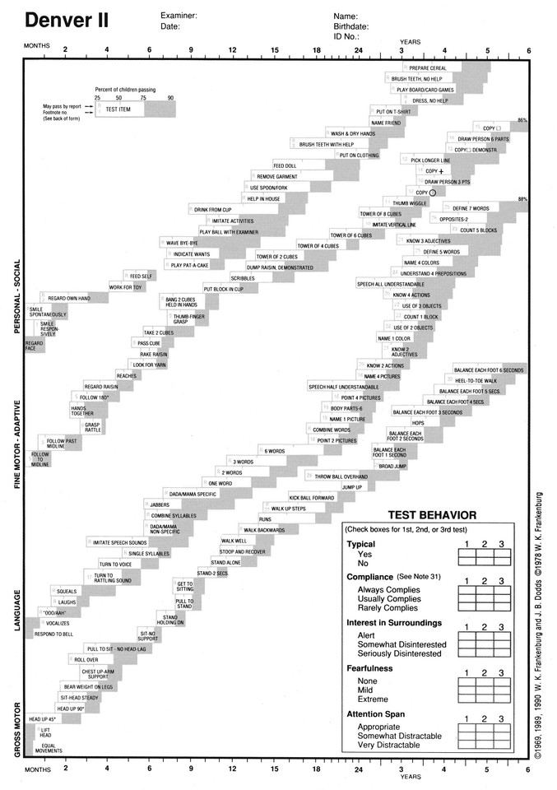

Slide 43
Developmental Screening Tools
Ages and Stages Questionnaire (ASQ):
For children aged 2 months to 60 months
Takes approximately 10 minutes to complete
Assesses 5 developmental domains, with 6 questions per domain
Each question has a set of responses such as Yes, No, or sometimes
Simple, easy-to-understand language
Straightforward scoring system
Can be completed by parents themselves
Once familiar with ASQ, parts of it can be used to assess a child's development
Allows for monitoring of child development before the next appointment
Recommended as a pre-referral tool to Paediatricians to assist in triaging areas of concern and determining the level of support needed

Slide 44
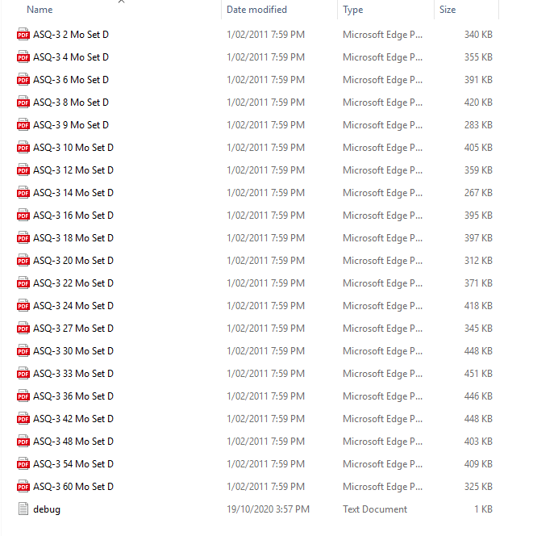
Ages and Stages Questionnaire (ASQ)

Slide 45
Ages and Stages Questionnaire (ASQ)
Sensitivity and specificity about 85%
Translated ASQ available in over 40 languages
No training required to administer
https://agesandstages.com/

Slide 46
Parent evaluation of developmental status (PEDS)
10 item parent questionnaire that covers the age range from birth to 8 years
Any parental concerns about the child’s development are elicited by questions to which parents respond with a simple yes/no answer, with space for elaboration
Parent responses are then transferred to a score sheet and then interpreted on an algorithm that provides a number of specific suggested actions
Similar to ASQ, reports can be completed before the consultation – either at home or in the waiting room – or they can be given to parents during a consultation to be completed and returned later
It takes parents several minutes to complete, and practitioners several minutes to score, so that it is feasible for use in a busy practice
Translated PEDS-R® Response Forms are available in 30 languages
PEDS-R® online, self-paced tutorial, takes 1.5 hours - https://www.rch.org.au/ccch/peds/training/#peds-r-online-self-paced-tutorial

Slide 47
Interim assessment - History
Birth history – preterm/ IUGR/ resuscitation/ prolonged hospitalisation/ maternal drugs, alcohol, smoking, infections/ severe jaundice
Family history of DD, ASD, syndromes
Consanguinity, miscarriages, still birth
Carer mental health and education
H/O developmental regression
Past medical history – trauma, witness to DV, medical illnesses, seizures
Basic needs – nutrition (dietary history), attention from caregivers, education…
Medications

Slide 48
Interim assessment - Examination
General exam - any dysmorphic facies
Neurocutaneous stigmata
Growth including Head circumference
Neurological examination

Slide 49
Interim assessment - Investigations
FBE, LFT, KFT, CK, Iron studies, TFT, Microarray, Fragile X, Urine metabolic screen
Hearing/ Vision
EEG – if seizures
MRI – Developmental regression, seizures, microcephaly, dysmorphism
Most cases investigations have poor yield

Slide 50
Referrals
If delay in one area and no other concerns - implement strategies to support development (play-based learning, reading together, attending playgroups and childcare) and refer for community-based therapy
If concerns >1 area, or additional risk factors or co-morbid health conditions or unclear picture, refer for a Paediatrician assessment following an ASQ (Ages and Stages Questionnaire), initiate ECIS funding and generate interim referrals

Slide 51
Referrals
While referring to a paediatrician, also initiate referrals for speech therapy, occupational therapy, psychology, social work, dietician, or respite services, as necessary. Keep in mind that waitlists for these services are often long
If the child is under 7 years old and Global Developmental Delay (GDD) is suspected, initiate a referral to Early Childhood Intervention Services (ECIS), as no formal diagnosis is required for ECIS referrals for children under 7

Slide 52
Practical approach
Elicit parental concerns
Provide information – credible info from reputable websites
Referral and coordination - have a list of allied health ready
If concerned – REFER –> proven –> significant difference to outcomes
If in doubt - REFER –> untrue –> Reassurance would not hurt
Either way it’s a win win situation
The goal is to create an accurate profile of the child’s current strengths and weaknesses and to achieve the best possible developmental outcomes.

Slide 53
Jordan
3-year-old Caucasian boy
Mother seeking advice regarding his speech delay
Preschool teachers have told her that he is slow in speech compared to his classmates. Jordan has a vocabulary of about 10–12 words and has not started speaking in phrases
He can respond to his name and can follow simple instructions

Slide 54
Jordan
Further history - Full term/ uneventful neonatal period/ passed newborn hearing test/ never been hospitalised or exposed to any medications/ he has history of recurrent ear infections
Physical examination - no dysmorphic facial features and he is otherwise in good health

Slide 55
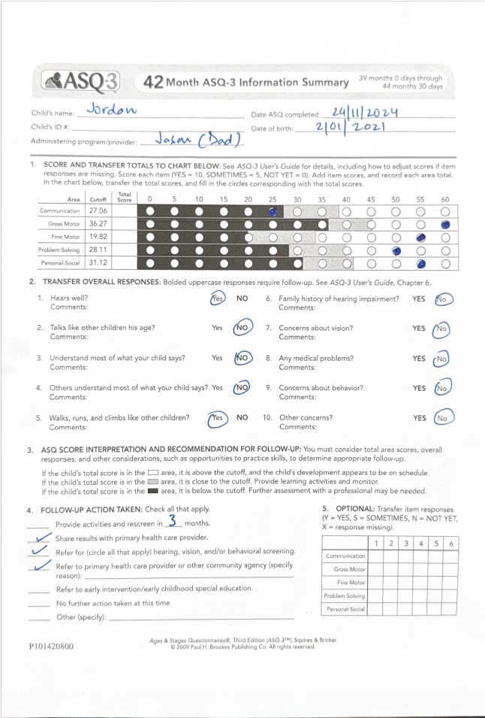
Jordan ASQ

Slide 56
Jordan
ASQ - Isolated expressive language delay

Slide 57
Jordan
Conclusion - You explain that Jason’s expressive language is delayed. At three years, he should be able to speak in 3-4 words sentences and have speech that is intelligible to strangers
Management - Because of the expressive language delay, you recommend a referral for a hearing test and put in a referral for speech therapy and Paediatrician

Slide 58
Dante
18-month-old child from a Sudanese background, recently migrated to Australia, Dad speaks good English and is interpreting for mum
During an immunisation catch-up session, you note that the child is not speaking, has minimal eye contact, no pointing
When discussed with the parents, they express some concern about a possible speech delay but remain hopeful that the child will improve over time
The child does not attend childcare
On observations: No dysmorphic facial features, the child is otherwise in good health. He is observed to be playing alone in the room, not engaging with siblings, exhibiting rough play, highly active, attempting to hit parents, and trying to escape the room

Slide 59
Dante
Further history - Full term/ uneventful neonatal period/ passed newborn hearing test/ never been hospitalised or exposed to any medications,10 years old first cousin in Africa is nonverbal and home bound
Examination - no dysmorphic features and normal neurology
ASQ

Slide 60
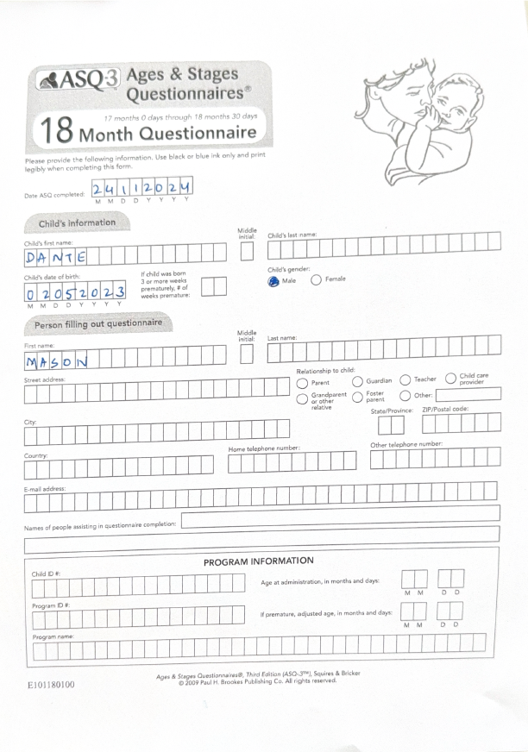
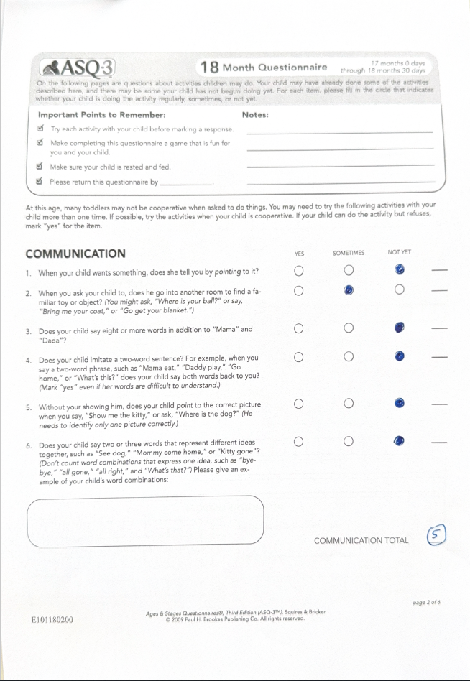
Dante ASQ

Slide 61
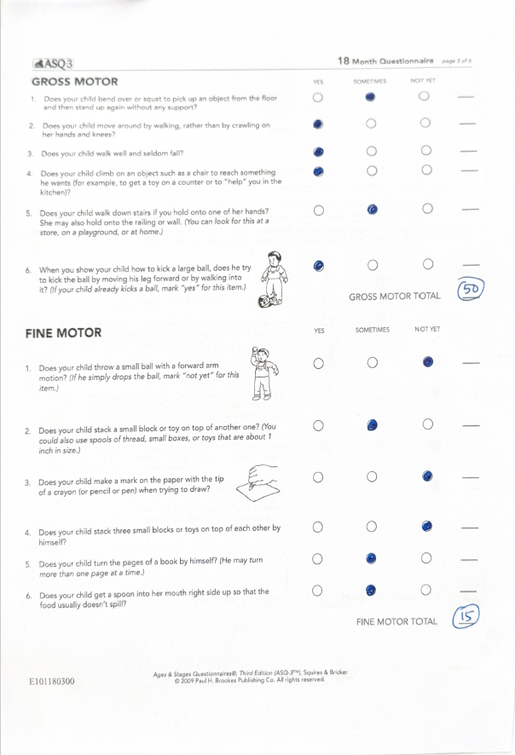
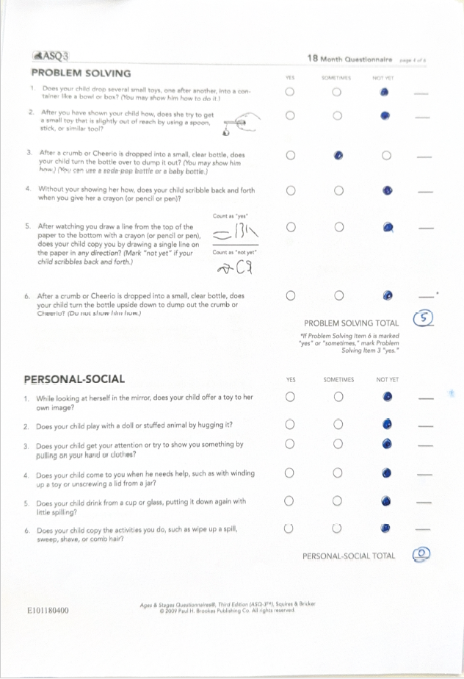
Dante ASQ

Slide 62
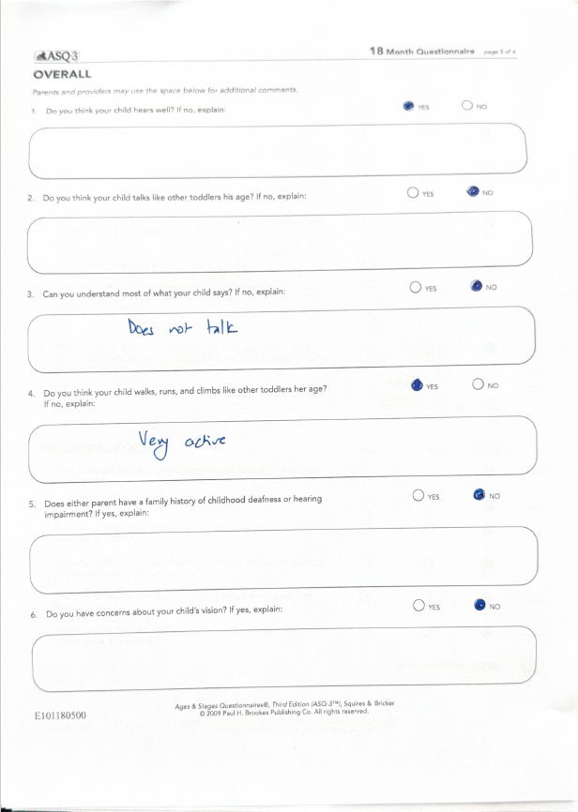
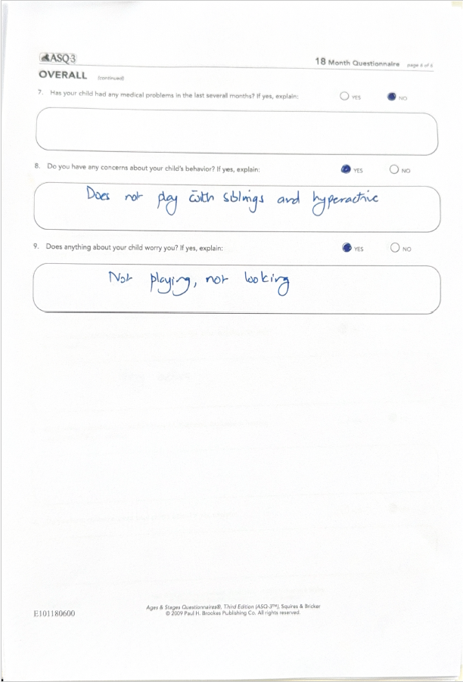
Dante ASQ

Slide 63
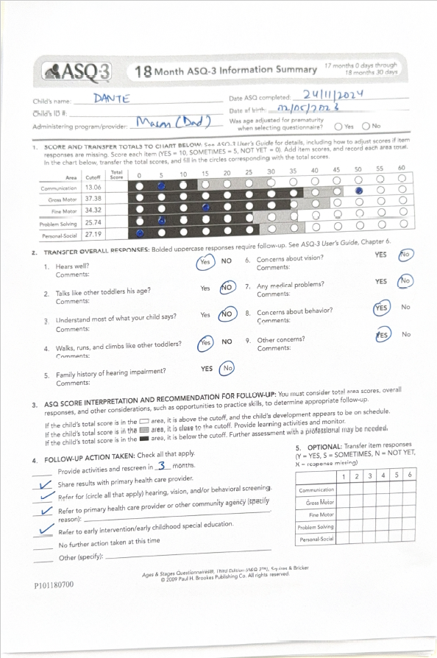
Dante ASQ

Slide 64
Dante
ASQ – expressive, receptive, personal-social skills, fine motor skills and problem-solving skills are severely delayed range
Gross motor skills are age-appropriate

Slide 65
Dante
Conclusion – You suspect GDD and Autism
Offer interpreter for mum
Acknowledge family’s views
Emphasise missed milestones (eye contact, pointing)
You explain that Dante is overall developing slow and that he needs further evaluation and therapy to bring best outcomes
Stress ++ importance of early intervention
You reinforce Dante’s positives which is his young age and his good gross motor skills

Slide 66
Next Steps & Referrals - Dante
ECIS Referral due to GDD
Referral to Paediatrician for comprehensive evaluation
Interim referral to Speech therapist and OT using EPC and mental health plans
Recommend childcare or playgroups
Check for hearing/vision issues or other contributing factors
Consider blood tests
Social worker referral to help assess the intervention and financial support
Provide Emotional Support and reassure parents and offer guidance on managing concerns

Slide 67


Role of GP beyond referral
Diagnosis of developmental delay - grief, time and financial burden, marital stress
LISTENER, ADVOCATE, ADVISOR
Notes:
Brings grief from the loss of potential unrealised dream for their child
The long term emotional and practical support to families is highly valuable

Slide 68
Key Takeaways
Early identification and intervention are crucial
Familiarise yourself with milestones and red flags
Use available tools for screening
Partner with families and specialists for comprehensive care

Slide 69
Early identification and management of developmental delay in children
Questions
riju.mittal@wh.org.au

Slide 70
Resources
Resources
Starting Blocks
National resource base on early childhood education and care.
https://www.startingblocks.gov.au
Raising Children Network
A wide range of resources for parents and caregivers.
https://raisingchildren.net.au/guides/a-z-health-reference/developmental-delay
Disability Gateway
Federal government website with comprehensive information and resources on topics relating to disability.
https://www.disabilitygateway.gov.au/
The A-List
Resources and information on autism.
https://www.mycarespace.com.au/alist
Just Like You
A program that educates primary school aged students on inclusivity and disability.
https://www.justlikeyou.org.au
All Play
Evidence-based resources to help parents, teachers, coaches, carers and health professionals working with children with developmental challenges.
https://allplay.org.au
Playgroup Australia
Playgroup Australia is a not-for-profit organisation and contains resource and research on playgroups, and links to state playgroup organisations.
https://playgroupaustralia.org.au
Parent support groups –
MyTime is a place where parents can share ideas and experiences with others who understand. It is for all parents and carers of children under the age of 18 who need a higher level of care than other children. They run various groups with facilitators and is free.
https://www.mytime.net.au/

Slide 71
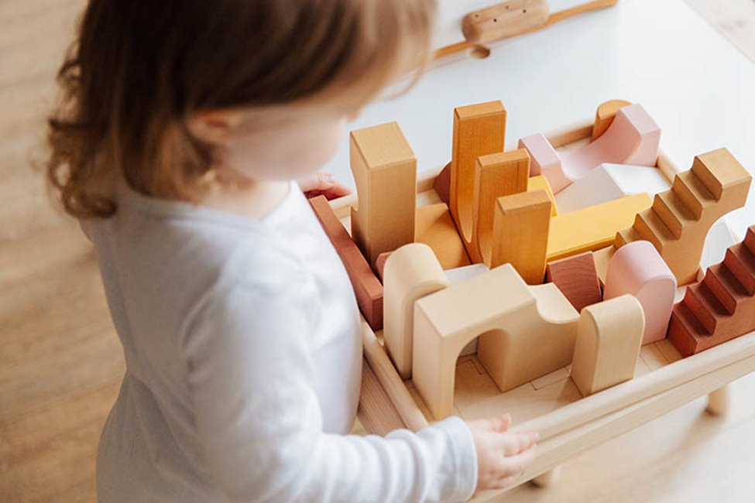
Resources
NDIS funding
https://www.ndis.gov.au/understanding/families-and-carers/early-childhood-approach-children-younger-9/developmental-delay-and-early-childhood-approach

Slide 72
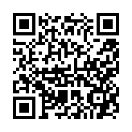
Session Conclusion
We value your feedback, let us know your thoughts.
Scan this QR code
You will receive a post session email within a week which
will include slides and resources discussed during this session.
Attendance certificate will be received within 4-6 weeks.
RACGP CPD will be uploaded within 30 days.
To attend further education sessions, visit,
https://nwmphn.org.au/resources-events/events/

